Slide 1
BS9001: Research experience
Meta-Analysis of Breast Cancer Using Data Science Techniques
by Justin Chia

Slide 2
Meta-analysis
What? - A statistical procedure for combining data from multiple studies
Why? – It synthesizes data across studies. It takes variations in results from different studies into consideration such as confounding factors and batch effects.
How? – Identifying a problem, doing a literature search, deciding on selection and inclusion criteria, data extraction, doing the meta-analysis
Focus for this project is on breast cancer

Slide 3
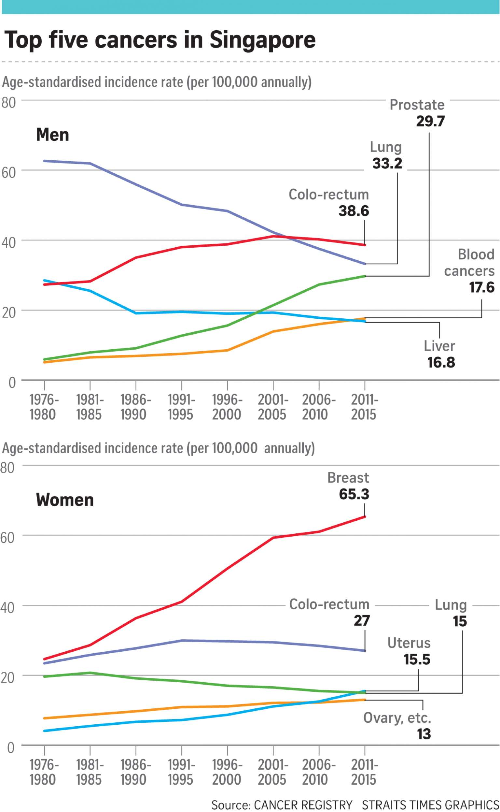
Breast cancer
Breast cancer is both the most common cancer and the most common cause of death among women
To understand its workings, it is important to understand the genetic profiling of genes that are significantly expressed in breast cancer.
The type of breast cancer analysed in this study is Invasive Ductal Carcinoma

Slide 4
Objectives of this rE
To learn how to use GEO to access datasets
To learn the basics of R programming
To perform basic data manipulation in R
To learn how to plot basic graphs and diagrams in R
To learn Rmarkdown syntax

Slide 5
Research process
Selection of scope and corpus
Data Extraction
Data Compression
Bootstrap
Jaccard coefficient and confusion matrix

Slide 6
Scope and corpus
Type of Breast Cancer selected: Invasive Ductal Carcinoma
GSE Series selected: GSE22544
Total number of patients: 20, 4 normal, 16 with IDC

Slide 7
Data extraction
Refer to extraction_markdown.html for code
Data was sourced using the GEO database and manipulated in R.
Data was extracted, cleaned and assigned to variables
Datasets were written into files for further use

Slide 8

Data compression
Gene symbol vector was first run adjusted using the unique function to remove any duplicated gene symbol names
The rows of the expression data frame that correspond to the gene symbols vector were sub-setted
The mean was then determined for multiple rows of the same gene
Files were read into .csv files
Refer to compression_markdown_test.html for code

Slide 9
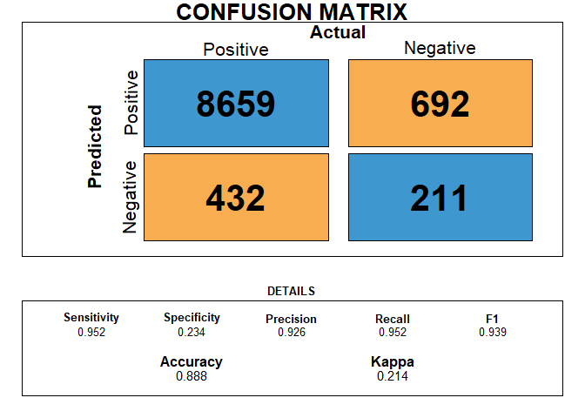
Bootstrap technique
2 methods were attempted to perform the bootstrap:
Method 1: Using nested ‘for’ loops to produce binary matrix. Method 2: Using “genefilter” package’s “rowttests” function. Method 2 was selected for its quicker running speed.
The “caret” package was installed to generate a confusion matrix with a single sampling as ground truth and the bootstrapped sampling as the observation.
The precision, recall, F1-score, and other relevant metrics were calculated.
Refer to extraction_markdown.html for code

Slide 10
Thank you

